Slide 1
Socrates
Critical Design Review

Slide 2
Agenda
Introduction
Motivation
Approach
Budget
Design
Standards
FMEA
Conclusion
Individual Reports
Charlie D

Slide 3
Agenda
Introduction
Motivation
Approach
Budget
Design
Standards
FMEA
Conclusion
Individual Reports
Charlie D

Slide 4
Introduction
Charlie D
Communications
Tim Kukowski
Ben Setterholm
Team Lead/Structure
Charles Denis
ADNCS
Jacob Gustafson
Brian Hanson
Nicholas Sloan
Power Management
Ethan Arendt
Nicholas Janak
Justin Seifert

Slide 5
Agenda
Introduction
Motivation
Approach
Budget
Design
Standards
FMEA
Conclusion
Individual Reports

Slide 6
Motivation
Charlie D
SOCRATES:
Signal
Opportunity
CubeSat
Ranging
And
Timing
Experiment
System

Slide 7
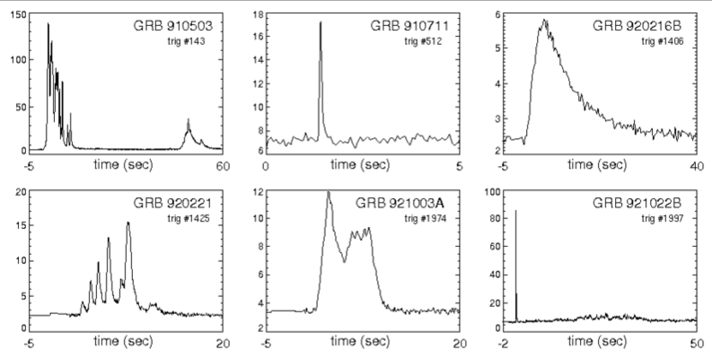
Motivation
Charlie D
Payload
Gamma Ray Incident Detector (GRID)
What GRID does?
Detect gamma ray events to conceptually prove deep space navigation concepts
This figures shows six examples of known Gamma Ray bursts from our universe. The data in the plots represents the relation between Kilo-Electron Volts and Seconds in time.

Slide 8
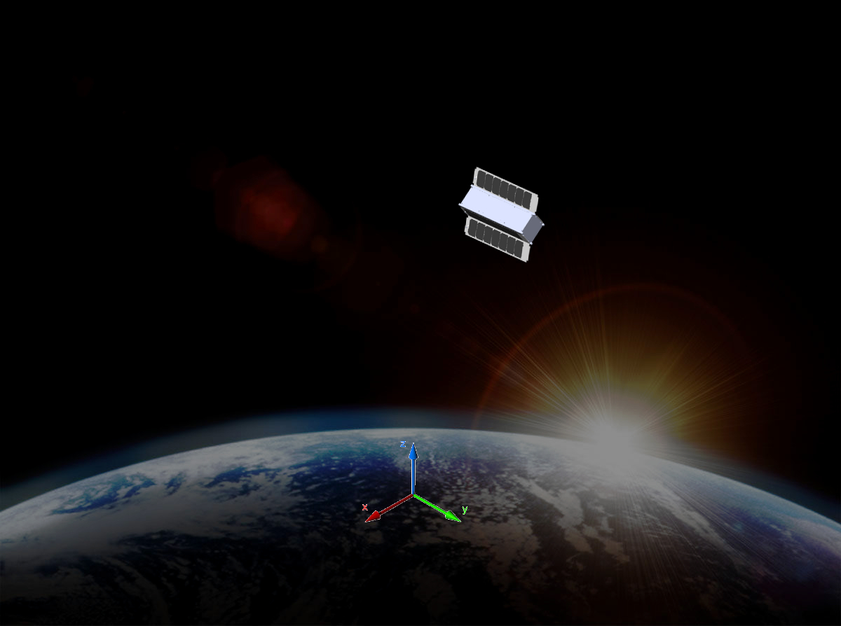
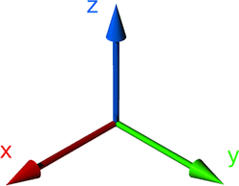
CONOPS
Charlie D
SOCRATES
Operating in LEO (~410km/~255 miles)
Operating under photovoltaic power
Continuous environmental polling
Triggered by GRB
GRID data
GPS “best XYZ” and velocities
Attitude vector
Real time
Radio Communication
Transfers GRB telemetry to ground stations

Slide 9
Motivation
Tim K
Requirements
The CubeSat shall determine and relay a relative position solution (i.e., relative to the formation) with an accuracy of 10 meters (1 standard deviation)
The CubeSat shall determine and relay a relative attitude solution with an accuracy of 10 mRad.
The CubeSat shall maintain a clock offset or timing accuracy (relative to the formation) better than 10 µs.

Slide 10
Motivation
Tim K
Derived Requirements
Shall accept “GRID” as a payload
Supplies payload with power (5Whr)
Communicates with payload (via CAN bus)
Provides GRID with environmental data (time, attitude, position)
Compiles and transmits data from GRID to ground network
Shall meet NASA CubeSat Launch Initiative (NCLI) requirements
Notes:
NASA CubeSat Launch Initiative - http://www.nasa.gov/pdf/627972main_LSP-REQ-317_01A.pdf

Slide 11
Agenda
Introduction
Motivation
Approach
Budget
Design
Standards
FMEA
Conclusion
Individual Reports

Slide 12
Design Approach
Tim K
Goals
Successfully carry GRID into LEO
Utilize subsystems to support GRID and transmit data
“Off-the-Shelf”
Focus on data rather than hardware
Proven space heritage
Corporate support for products
Subteams
Individuals become specialists for their subsystem

Slide 13
Agenda
Introduction
Motivation
Approach
Budget
Design
Standards
FMEA
Conclusion
Individual Reports

Slide 14
Purchases
Jake G
Flight Computer
GPS
Receiver Unit
Antenna
Attitude
Gyroscopes
Passive Magnetic Bar
Power
Power Management Board
Batteries
Deployable Solar Panels
Radio
Radio Unit (provided by Aerospace Corp)
Antenna (Patch)
Structure
Materials
Insulation
Cabling, etc

Slide 15
Budget
Jake G
Initial Budget
Lower ($50,000)
Passive Attitude Control
Solar Panels on Faces
Middle ($75,000)
Passive Attitude Control
Deployed Solar Panels
Upper ($100,000)
Active Attitude Control
Deployed Solar Panels
NASA Proposal

Slide 16
Final Budget
Item | Model | Source | Cost
Flight Computer | A712D | GOMSpace | $5,400
GPS receiver | OEM615 | Novatel | $6,000
GPS Antenna | Single Frequency MircoStrip | Antdevco | $5,000
Batteries | NanoPower BPX | GOMSpace | $6,200
Power Management Board | P31us | GOMSpace | $6,200
Radio | MM2-TTL | Freewave | $1,500*
Antenna | CS-CPUT-STX-02 | ClydeSpace | $4,725
Deployable Solar Panels | SP-L-DD1S3U-0039 | ClydeSpace | $40,300**
Gyroscopes | ITG-3050 | InvenSense Inc | $5
Structure | N/A | Century College | $1,200
Passive Attitude Magnet | N/A | K&J Magnetics | $5
Hysteresis Rods | Hymu80 | RAM | $45
*Provided free of Cost from AeroSpace Corp.
** Denotes the cost of 2
Final Cost: $75,080

Slide 17
Agenda
Introduction
Motivation
Approach
Budget
Design
Standards
FMEA
Conclusion
Individual Reports

Slide 18
Design - Data Packet
Charlie D
GRID
GRID will run on a FIFO memory buffer
When a GRB is realized GRID will trigger the flight computer to store data to dedicated memory for beginning at -1min and +3 min from time of trigger.
This is known as our “packet”
GPS
GPS will run on a FIFO memory buffer
Flight computer trigger stores GPS best XYZ and velocity related to the start time of the packet
Knowing orbital elements we know the following positions of SOCRATES through the duration of the packet
End time GPS best XYZ and velocity is stored to calculate drift of measurements if applicable.
Attitude
Attitude is consistently calculated by the flight computer and stored in an accessible memory location
Flight computer trigger stores attitude at the start time and 15 second intervals through the packet duration.
Time
System time delay will be monitored as the difference between flight computer time (RTC) and GPS time
When difference > 10µs the flight computer real time clock is reset to GPS time.

Slide 19

Design - Data
Charlie D
Packet size per GRB
GRID = $\left(\frac{8 bits}{10µs}\right)×\left(\frac{1×{10}^{6}µs}{1 sec}\right)×\left(\frac{60sec}{1 min}\right)×4 min=19.2×{10}^{7}bits$
GPS = $\left(1064 bits\right)×\left(1t_{s}+1t_{f}\right)=2128 bits$
Attitude = $\left(288 bits\right)×\left(\frac{4 reads}{1 min}\right)×4 min=4608 bits$
Total = GRID + GPS + Attitude = ~19.2 MB per event.
Packets will be stored onboard flight computer
Packets will be transmitted with error checking to ground network when available.
Packets will then be released for memory consideration.

Slide 20
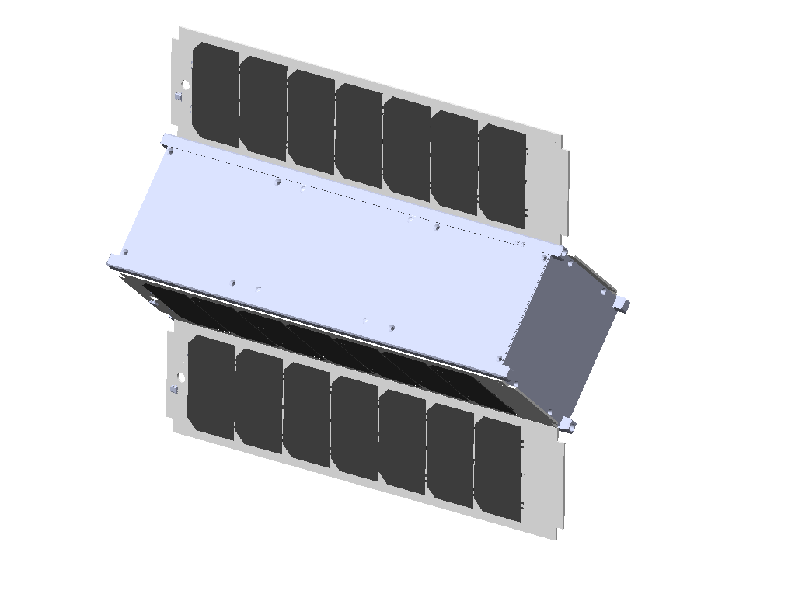
Design - Model
Charlie D

Slide 21
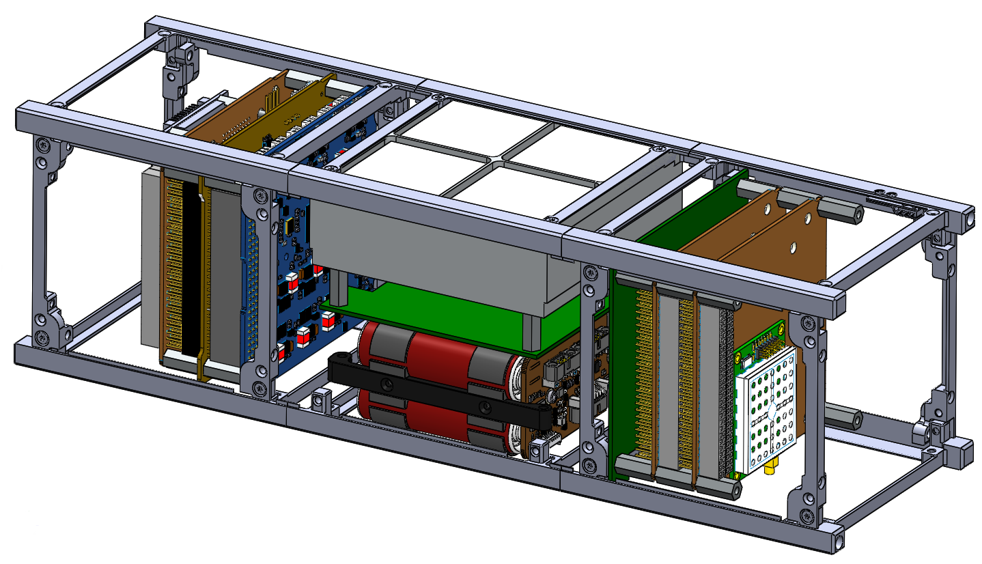
Design - Model
Charlie D

Slide 22
Design - Structure
Charlie D
Century College
Sub Contracted by UMN
Shall design a structure
Shall meet all NCLI and other NASA requirements
Shall meet requirements for P-Pod launcher
Shall meet center of mass requirement
Shall meet moments of inertia requirement
Shall incorporate GRID into solid structure
Shall manufacture structure
Shall meet all requirements agreed upon

Slide 23
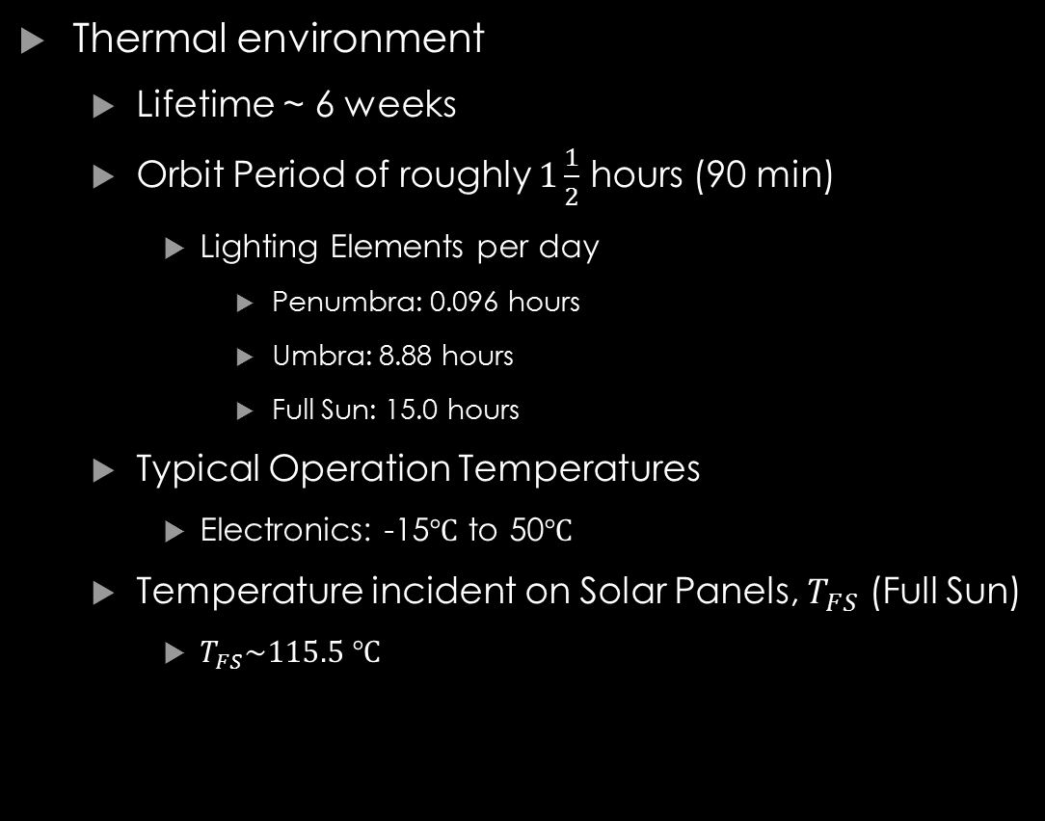
Design - Structure
Nick J
Thermal environment
Lifetime ~ 6 weeks
Orbit Period of roughly $1\frac{1}{2}$ hours (90 min)
Lighting Elements per day
Penumbra: 0.096 hours
Umbra: 8.88 hours
Full Sun: 15.0 hours
Typical Operation Temperatures
Electronics: -15$℃$ to 50$℃$
Temperature incident on Solar Panels, $T_{FS}$ (Full Sun)
$T_{FS}\sim 115.5 ℃$
Earth
Full Sunlight
Penumbra
Umbra

Slide 24

Design - Structure
Nick J
Solar Panels: Used as heat shielding
Absorptivity, $α=0.805$
Emissivity, $ε=0.825$
$β=\frac{α}{ε}=0.975$
A high $β$ value is indicative of the surface being warm, and hence, a good absorber
A low $β$ value is indicative of the surface being cool, and hence, a good radiator
Below the solar panels, the body of SOCRATES will be painted white - Passive
White coating helps to decrease the amount of thermal energy absorbed
$α=0.22, ε=0.88$
Internally, the surfaces will be silvered to refract radiation and keep the electronics cool
$α=0.07, ε=0.78$

Slide 25
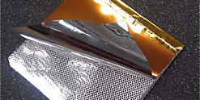
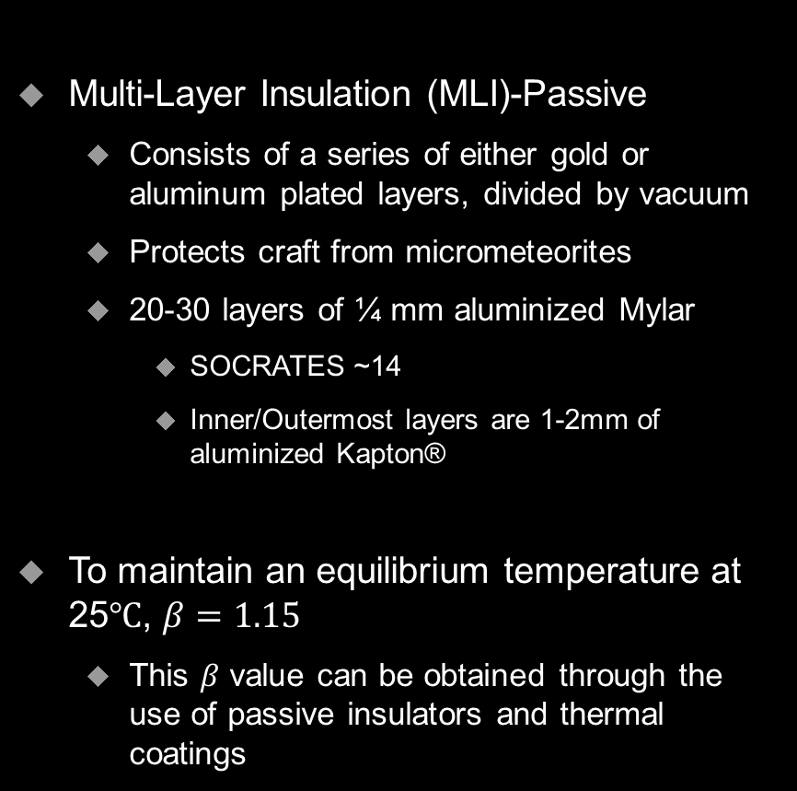
Design - Structure
Nick J
Multi-Layer Insulation (MLI)-Passive
Consists of a series of either gold or aluminum plated layers, divided by vacuum
Protects craft from micrometeorites
20-30 layers of ¼ mm aluminized Mylar
SOCRATES ~14
Inner/Outermost layers are 1-2mm of aluminized Kapton®
To maintain an equilibrium temperature at 25$℃$, $β=1.15$
This $β$ value can be obtained through the use of passive insulators and thermal coatings
http://www.dupont.com/products-and-services/membranes-films/polyimide-films/brands/kapton-polyimide-film/uses-and-applications/kapton-role-on-rosetta-mission.html

Slide 26
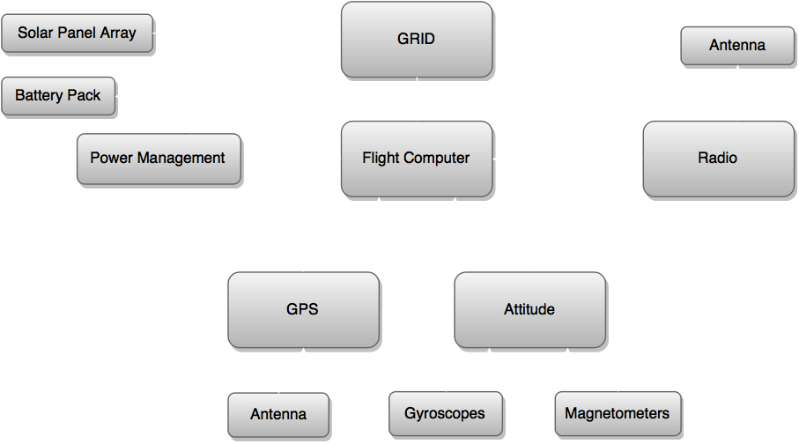
Design – Block Diagram

Slide 27
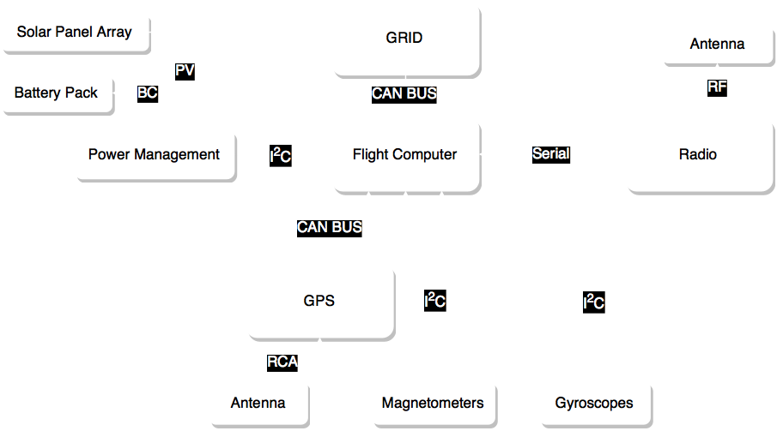
Design - Protocols
Jake G

Slide 28
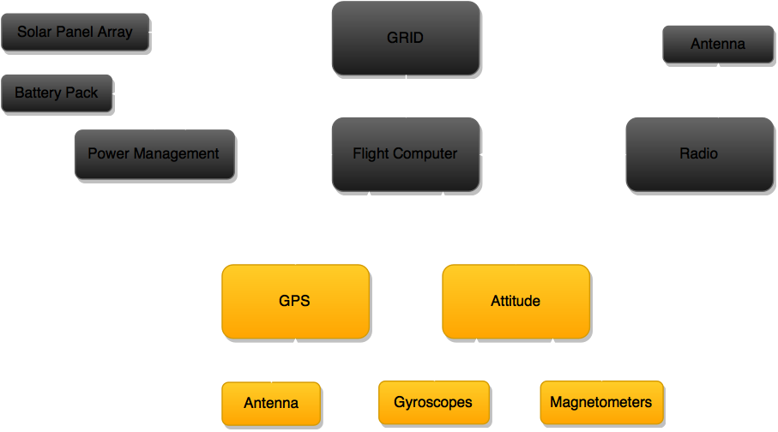
Design - ADCNS

Slide 29
DESIGN - ADNCS Overview
Nick S
Attitude Determination
Gyroscope
Magnetometer
Passive Magnetic Attitude Control
Pointing Accuracy <5º
GPS
Planned Circular Orbit
410 km Altitude
Inclination 60º
Notes:
SLIDE 19

Slide 30
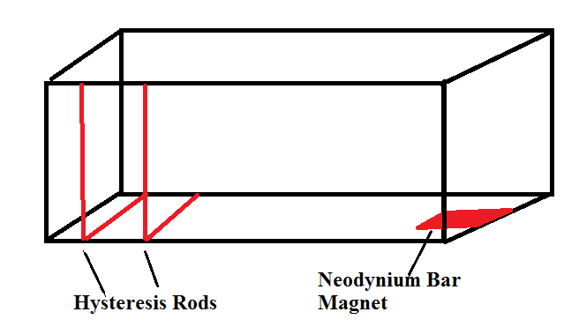
DESIGN - PMACS
Nick S
Passive Magnetic Attitude Control
Bar Magnet placed within SOCRATES produces torque to align itself with Earth’s magnetic field
Hysteresis rods damp out oscillatory effects
Why use it?
Proven space heritage
No power required
Notes:
SLIDE 21, PMAC systems have been successfully used on the University of Michigan’s RAX Cubesat and Colorado’s CSSWE cubesat (Colorado Student Space Weather Experiment)

Slide 31
Design - PMACS
Nick S
System consists of:
One 0.8A-m² Neodynium bar magnet
4 HyMu-80 hysteresis rods 95mmx4mm
All components made from HyMu-80 magnetic alloy
Expected settling time of 18 hours
Verification ongoing
Notes:
SLIDE 22

Slide 32
Design – PMACS Simulation
Nick S.
Before starting:
Determine environmental torques
Gravity gradient
Aerodynamic
Sun pressure
Solar panel deployment
Determine minimum required magnetic moment
Identify resonance moments
Dependent on structural moments of inertia
Identify Planned Orbit
Torque Source | Magnitude (N-m)
Gravity Gradient | 6e-8
Aerodynamic | 8e-8
Radiation Pressure | 2.6e-9
Solar Panels | 1e-7
*Colorado Student Space Weather Experiment
Notes:
SLIDE 23

Slide 33
Design – PMACS Simulation
Nick S.
Uses MATLAB ode45
Simulation Algorithm
Input body attitude and angular spin vectors, flight time
Calculate change in body attitude
Estimate SOCRATES position and magnetic field from flight time
Translate field vector to SOCRATES frame
Determine hysteresis rod moment from vector change in magnetic field
Calculate torque from magnetic moment and field
Apply torque to estimate change in angular velocity
Propagate results to next time-step
Notes:
SLIDE 24

Slide 34
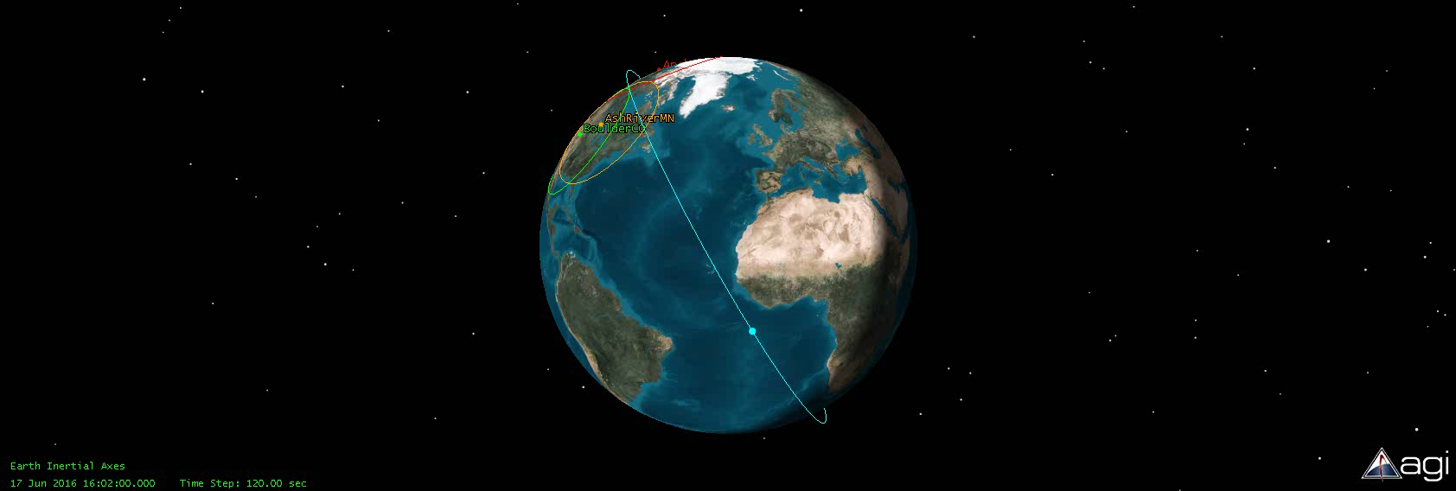
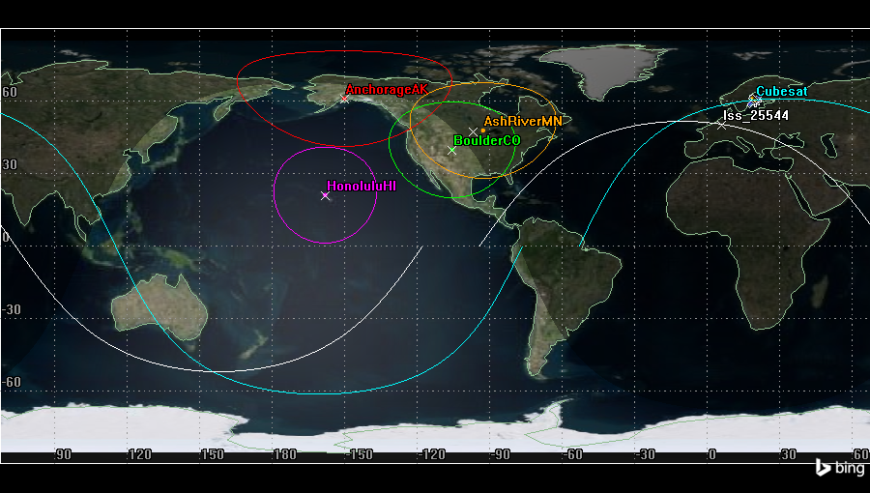
Design - ADNCS
Orbit
Altitude: 410±100 Km
Inclination: 60±10 Degrees
Jake G
Notes:
Moved this slide due referencing STK and orbits before GPS
Orbit uncerinaty is based on testing.
The intial orbit was based on ISS which is shown
However increasing Incliaction gives us more Sunlight time as well as more time, however going over 71 degrees moves us more towards a polar orbit, and then will hurt our sunlight but at 71 it will increase
We could go less Inclination but our data time goes down as well as sunlight time will get smaller, though not by much the Access time will become less and less
As for Altitude we get around the same numbers for adding or subtraction 100km if we go over our Access goes down a lot due to limit range of the Antenna, and going lower 310 we are getting out of leo as its above (220km) however if more is requested we could do more

Slide 35
Design - ADCNS
Jake G
GPS (Novatel 615 with Single Frequency MicroStrip)
Output (50 Hz) (Binary)
GPS Time
GPS Position and Standard deviation
GPS velocity and Standard deviation
Number of Satellites
Space Heritage*
* Provided in supplemental material.

Slide 36
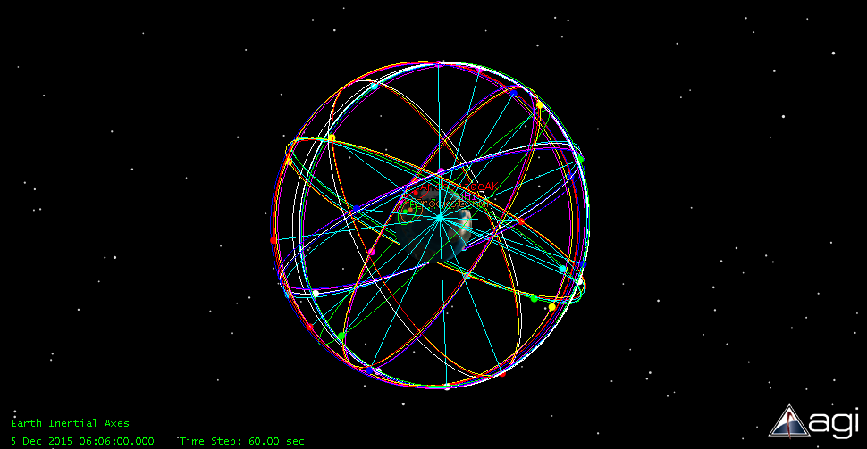
Design - ADCNS
Jake G
Satellite Verification
Need 4 satellites
Verified with STK software

Slide 37
DESIGN ADNCS
Brian H
Attitude determination
Input from gyroscope and magnetometers
Solution is 3×3 DCM
High level description
Integrating angular velocity
Angular velocity integration slowly drifts
Vector matching of magnetic field
Notes:
Don’t need full sentences
Since the earths magnet field is know if you know what a vector is you can use that to reset your Attitude solution

Slide 38
DESIGN ADNCS
Brian H
Need vector matching to start
Overview
Read gyroscope data
Integrate angular velocity
Reset attitude solution if vector matching is found
Notes:
Please read the paper

Slide 39
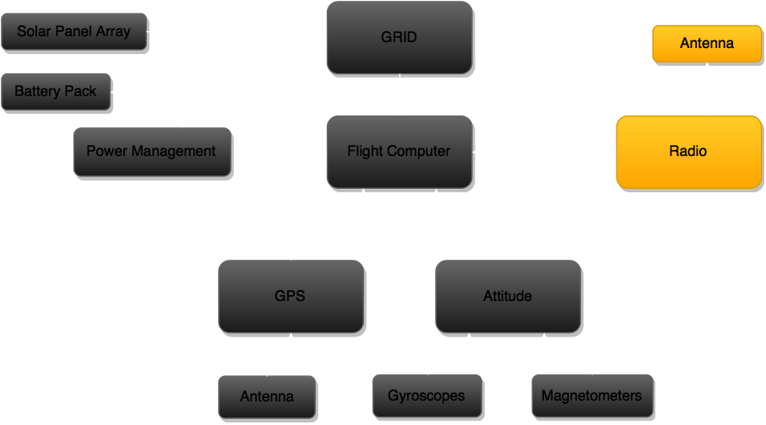
Design - Communications

Slide 40
Design - Communications Overview
Tim K
Maximum total theoretical data that can be transferred per day: 50 MB
Effects that reduce transfer rate
Weather
Communications Algorithm
Random Data Errors
Expected science data transfer per day: 15 MB
Based on calculations
Guaranteed total data transfer per day: 10 MB
Radio data from Aerospace Corp.
Notes:
Predicted assumes 40% weather throughput, maximum expected data errors, and 1 MB of other data transferred per day (handshakes, diagnostics, log files)

Slide 41
Design – Communications Algorithm
Ben S
Step 1: Active Pinging
Check if any other ground stations are currently in contact with SOCRATES
If not, send hail signal once every 3 seconds

Slide 42
Design – Communications Algorithm
Ben S
Step 2: Establish Connection
SOCRATES replies to hail
SOCRATES transmits GPS location, heading, and velocity information
SOCRATES transmits number of files ready for downlink

Slide 43
Design – Communications Algorithm
Ben S
Step 3: Computation
Ground station determines communication time

Slide 44


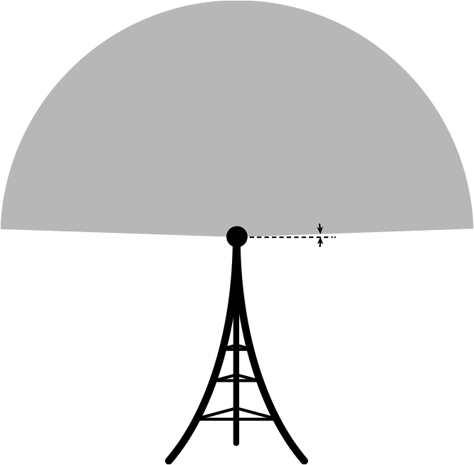
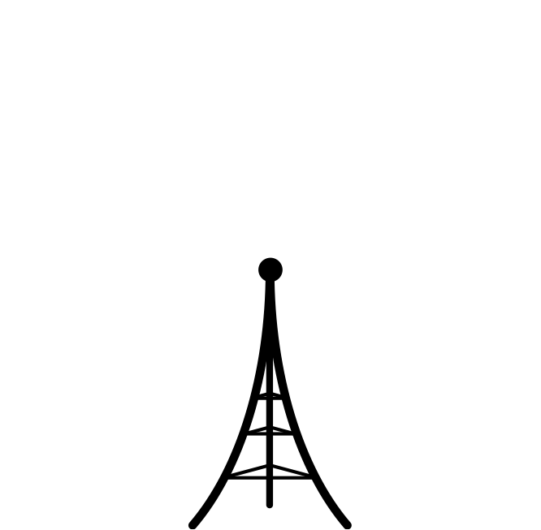

Design – Communications Algorithm
Ben S
Step 3: Computation
Ground station determines communication time
2°
2000 km

Slide 45


Design – Communications Algorithm
Ben S
SOCRATES makes contact
Determine range
Step 3: Computation
Ground station determines communication time

Slide 46
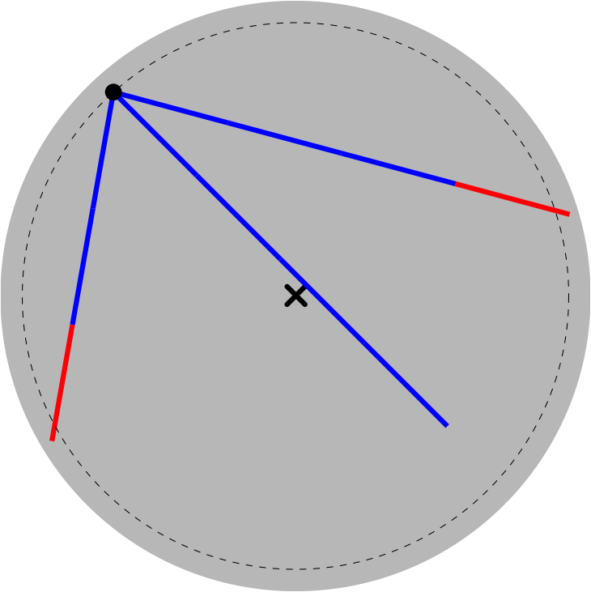
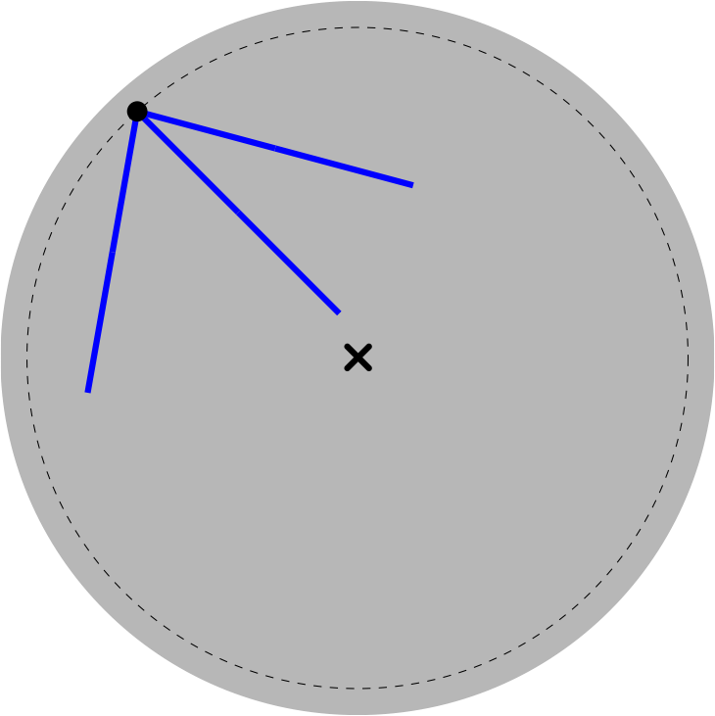
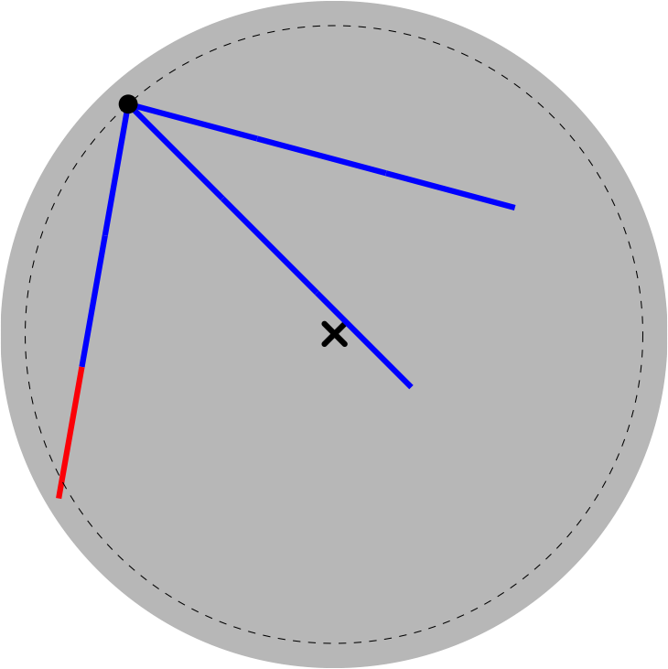
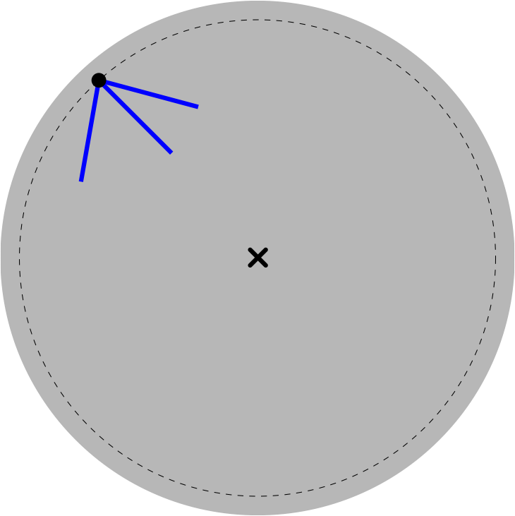
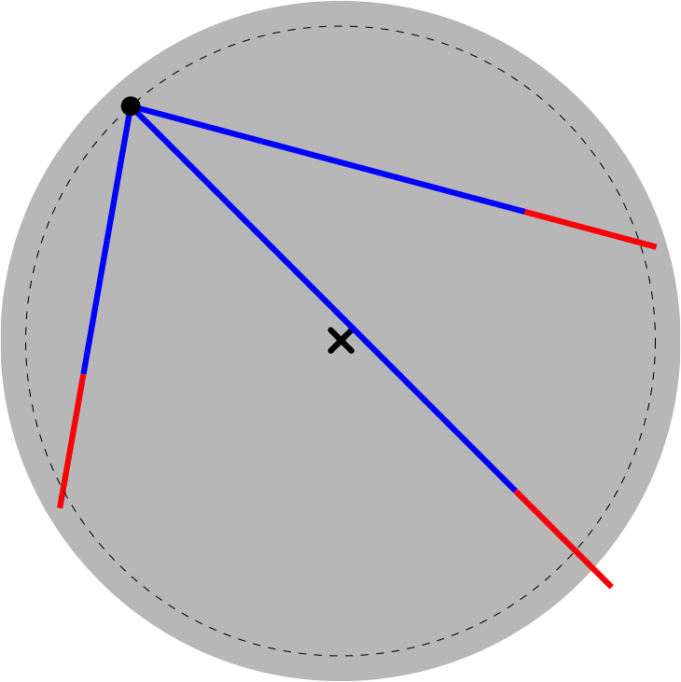
Design – Communications Algorithm
Ben S
SOCRATES makes contact
Determine range
Forward time step
3 second intervals
Step 3: Computation
Ground station determines communication time

Slide 47
Design – Communications Algorithm
Ben S
Step 4: Command
Ground Station sends command code
transfer queued file
transfer log file
diagnostics
delete queued file
delete all data files
SOCRATES purges marked files
delete log file
reboot OS
goodbye
kill

Slide 48
Design – Communications Algorithm
Ben S
Step 5: Transmit Data
SOCRATES transmits one 128 kB packet
5 time steps
Selective Repeat ARQ (Automatic Repeat Query) protocol

Slide 49
Design – Communications Algorithm
Ben S
Step 6: Error Checking
Ground Station computes checksum
Ground Station transmits checksum

Slide 50
Design – Communications Algorithm
Ben S
Step 7: Confirmation
SOCRATES checks checksum
SOCRATES appends log file
SOCRATES marks file for deletion if transmission successful
SOCRATES relays success/failure to ground station
SOCRATES awaits next command

Slide 51
Design – Communications Algorithm
Ben S
Step 4: Command
Ground Station sends command code
transfer queued file
transfer log file
diagnostics
delete queued file
delete all data files
SOCRATES purges marked files
delete log file
reboot OS
goodbye
kill

Slide 52
Design – Communications Algorithm
Ben S
Diagnostics
Onboard Time
GPS Position, Velocity, Satellite Lock
Battery Status, Panel Cell Performance
Attitude Magnetic Lock
Data Storage Check
Detector Diagnostics

Slide 53
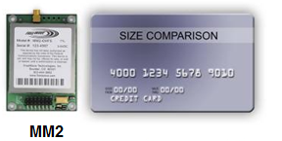
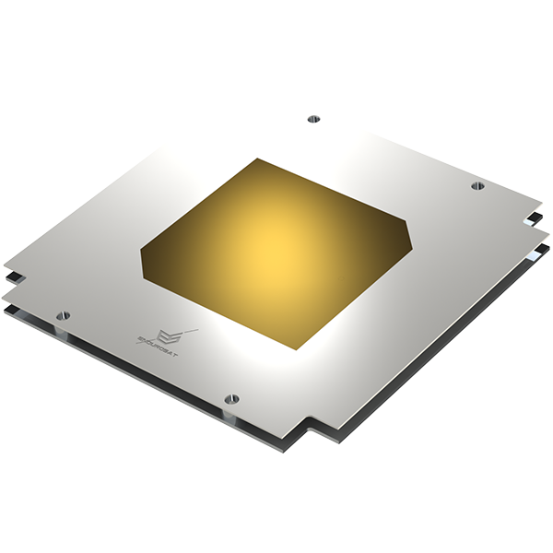
Design - Communications Hardware
Tim K
FreeWave Radio @ 915MHz
Compact radio with high data rate
Radio from Aerospace Corp.
Patch Antenna
Low Profile
Passive control
*Image provided from endurosat

Slide 54
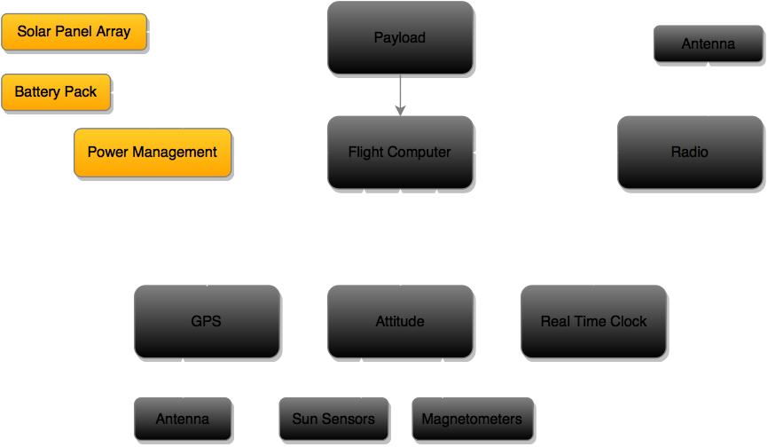
Design - Power

Slide 55
Design – Power
Justin S
Overview
Power Requirements
Supply power for continuous operation of all system components
Remain unpowered through launch, and 45 mins after deployment
Power Supply vs Power Draw
Environmental Factors
Final Power Components
Addition of deployable solar panels

Slide 56
Design – Power
Justin S
Component | Power Consumption (Watts)
Payload (GRID) | 5
Flight Computer | 0.33
Magnetometers | 0.06
Gyroscopes | 0.02
GPS Receiver | 0.99
GPS Antenna | 0.3
Radio & Antenna | 0.105 Idle 0.45 Receiving 4.275 Transmitting
EPS | 0.21
Solar Panels | N/A
Batteries | 0.07
Total | 7.085 / 7.43 / 11.26
Power Demands:
Power Supplied Per Orbit:
4.21 Wh - 16.1 Wh
Battery Operational Range:
68 Wh – 77 Wh

Slide 57
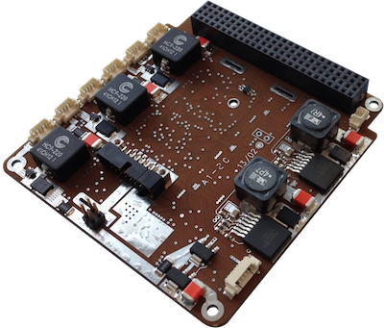
Design - Power
Final Design Components
Power Management Board: P31us – GomSpace
2 regulated Power buses: 3.3V at 5A and 5V at 4A
High and low voltage surge protection
User control of on/off state of bus outputs
4 operating states dependent on battery voltage
Measures/Records:
Current in/out of solar panels
Battery voltage
Voltages into output bus & current out of all power output channels
Temperatures of components
Justin S
*Image provided from GomSpace

Slide 58
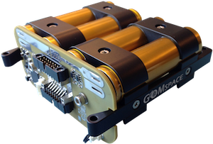

Design - Power
Justin S
Final Design Components
Batteries: BPx – GomSpace
8 ion lithium ion cells
Nominal voltage 12-16.8 V, 5.2 Amps
Operating power capacity 77 W – 68 W
Compatible with P31-us EPS board
*Images provided from GomSpace

Slide 59
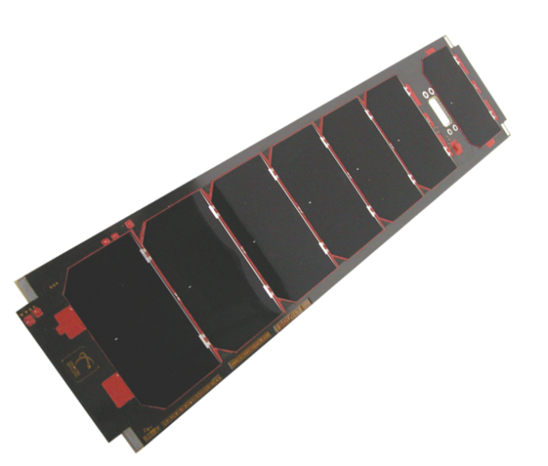
Design - Power
Double sided deployable solar panels
Justin S
Final Design Components
Solar Panels: SP-L-S3U-0016-CS – ClydeSpace
7 solar cells with 28.3% minimum efficiency per 3U side
Integrated temperature sensors
6.26 – 8.63 W produced in -40 – 80 degrees Celsius
Can be integrated with multiple additional sensors
Space heritage with NASA Firefly
2nd 3U side solar panel (reverse side)
3U side solar panel
Delployable Solar Panels: SP-L-DPLS3U-0038 – ClydeSpace
2 double sided deployable solar panels
7 solar cells per side with 28.3% minimum efficiency
135 degree offset from side panels
Dual redundant thermal knifes
Space heritage with Ukube-1 mission
*Image provided from ClydeSpace

Slide 60
Design - Power
Nick J
Power order of operations
SOCRATES shall remain powered off from the time of delivery to the launch vehicle through orbit deployment
Thermal knife is used to deploy the solar array
After ~45 minutes into orbit -- systems deploy
Solar power is collected until a minimum voltage is attained 3.3V
Power management board is powered on and begins operation

Slide 61
Design - Power
Nick J
The power management board controls:
When systems are powered on/off
When to solely charge battery for power supply during umbra
No tentative plans to have any systems powered completely off other than the initial launch sequence and prior to re-entry
Systems will be powered down and the batteries will be depleted
Re-entry into the atmosphere

Slide 62
Design – Power Operations
Ethan
Overview of power system mission
Split into two stages of operations
1) Deployment
2) Mission

Slide 63
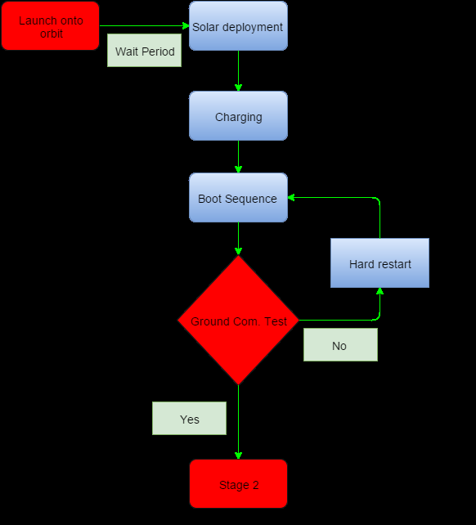
Design – Deployment
Ethan

Slide 64
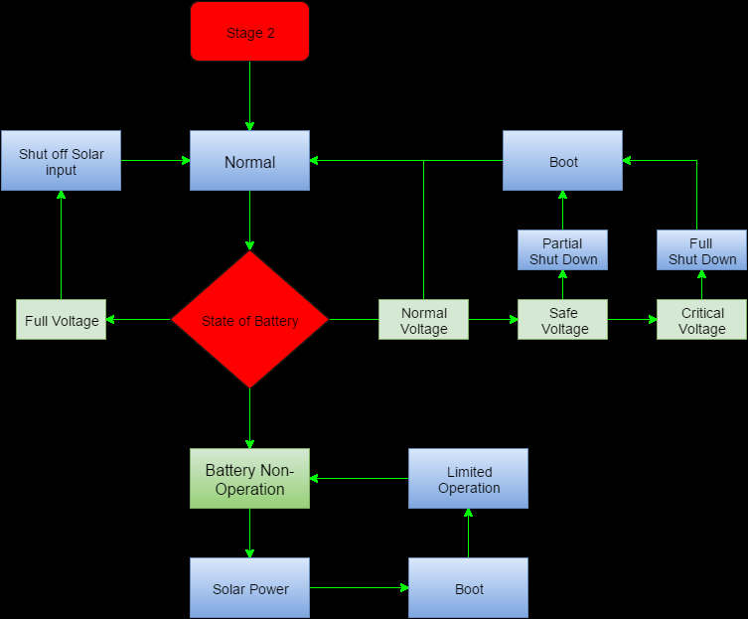
Design – Mission
Ethan

Slide 65
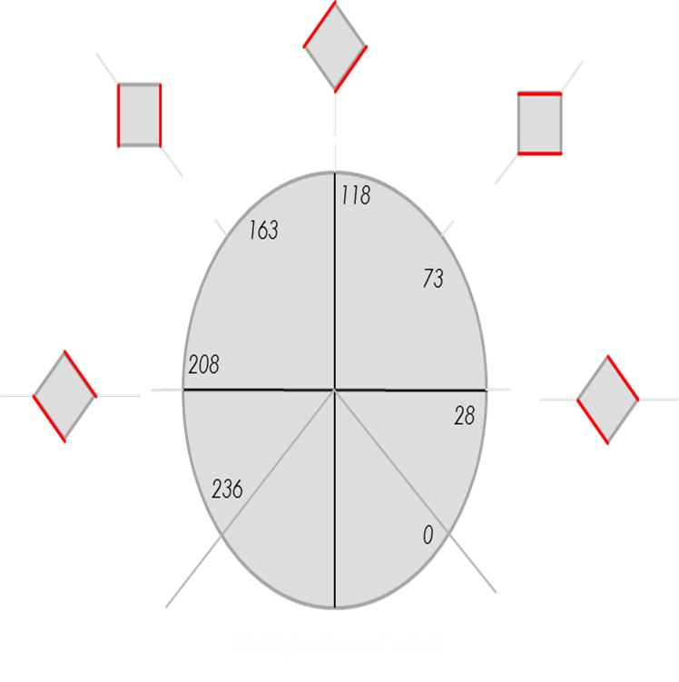
Charge Discharge
Ethan
Low
1 panel @ 45 degrees
Middle
1 panel @ 90 degrees
High
2 panel @ 90 degrees
Power Mode | Idle (W) | Transmitting (W) | Receiving (W)
Low | 15 | -10.79 | -0.64
Middle | 15.73 | -11.52 | -1.37
High | 23.83 | -19.62 | -9.47

Slide 66
Agenda
Introduction
Motivation
Approach
Budget
Design
Standards
FMEA
Conclusion
Individual Reports
Charlie D

Slide 67
Standards
Tim K
CubeSat Design
6.2.3 – Defines form factor of CubeSat
No smaller than 1U (10x10x10cm) and no larger than 6U (30x20x10cm)
Dimensions are nominal
6.2.9 – CubeSat powered off until it leaves launch vehicle
6.2.14 – Design and hardware in compliance with NPR 8715.6
Minimize space debris
Many others
Notes:
To meet de-orbiting requirements an orbit of 650 km perigee altitude or less is required for current area-to-mass ratio (written in proposal)
http://www.nasa.gov/pdf/627972main_LSP-REQ-317_01A.pdf
http://orbitaldebris.jsc.nasa.gov/library/NPR_8715_006A.pdf

Slide 68
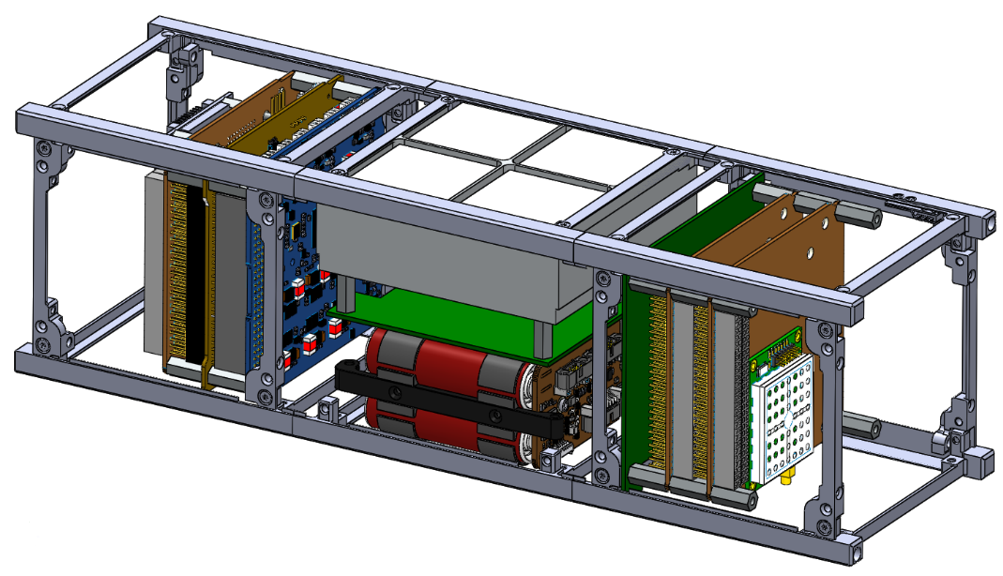
Standards
Tim K
Procedure
NOAA Commercial Remote Sensing Regulatory Affairs
Regulates communication of non-government remote sensing spacecraft
General Environment Verification Standard (GSFC-STD-7000)
System and environment testing for space hardware
LSP-REQ-317.01 P-POD and CubeSat requirements
NASA’s requirements for deployment from Launch Vehicle
Materials in accordance with NASA-STD-6016
Notes:
NOAA – Communications must be regulated by government for obvious reasons
GEVS – Adequate environmental testing or analysis must be done to prove the hardware can survive
http://www.nasa.gov/pdf/627972main_LSP-REQ-317_01A.pdf
http://orbitaldebris.jsc.nasa.gov/library/NPR_8715_006A.pdf
http://www.nesdis.noaa.gov/CRSRA/files/National_and_Commercial_Space_Programs_Act_60101.pdf
http://snebulos.mit.edu/projects/reference/NASA-Generic/GSFC-STD-7000A.pdf
http://nanoracks.com/wp-content/uploads/standard-materials-and-processes-requirements.pdf

Slide 69
Agenda
Introduction
Motivation
Approach
Budget
Design
Standards
FMEA
Conclusion
Individual Reports
Charlie D

Slide 70
FMEA - ADNC
Ben S
Failure Mode | Mechanism | System Effects | Probability | Severity | Risk Level | Mitigation
Gyroscope status read failure | Mechanical failure, software bug | Accuracy loss of attitude solution | Remote | Minor | Low | Test components before launch. Ensure low vibration during launch.
Tumbling | Passive control on only one axis | Communication problems, unexpected internal forces, insufficient power | Moderate | Critical | Unacceptable | Hysteresis rod control.
Lost position information | Could not get 4 GPS satellite lock | Cannot record position | Extremely unlikely | Critical | High | Moved antenna to point away from earth.
Failure to establish magnetic match | Faulty magnetometer read, damage | Reliance on gyroscope for attitude fix | Remote | Not Relevant | Low | Attitude determination no longer needed for mission. No action

Slide 71
FMEA - Communication
Ben S
Failure Mode | Mechanism | System Effects | Probability | Severity | Risk Level | Mitigation
Radio failure | Electrical short, internal damage | Communication is impossible | Remote | Catastrophic | Unacceptable | Test components before launch. Ensure low vibration during launch.
Hard drive failure | Random chance, internal damage | Data storage and retrieval is impossible | Remote | Catastrophic | Unacceptable | Ensure hard drive is space worthy before launch.
Files get stuck in code loop | Software bug, random glitch | Cannot send next file | Extremely unlikely | Moderate | Low | Command failsafes such as clear buffer, load next file, and reboot OS.
Data Transmission Errors | Atmospheric effects, noise | Incorrect data received | Nearly certain, frequent | Moderate | High | Error checking: Selective Repeat Automatic Repeat Query protocol during transmission, and overall checksum post packet send.

Slide 72
FMEA - Power
Ben S
Failure Mode | Mechanism | System Effects | Probability | Severity | Risk Level | Mitigation
Solar panels fail to deploy | Thermal knife | Not enough power, no mission | Remote | Catastrophic | Unacceptable | None.
Battery underload | Battery failure/dead | No battery power, system only on when solar panels illuminated | Moderate | Moderate | Moderate | Programmed software cases. Report problem in diagnostics.
Battery overload | EPS fails and overloads battery | Explosion | Remote | Catastrophic | Unacceptable | Test component before launch.

Slide 73
Non-FMEA Considerations
Ben S
Failure | Mechanism | System Effects | Probability | Severity | Risk Level | Mitigation
Launched into incorrect orbit | NASA launch error | Communication strain if below 50° and impossible below 20° | Remote | Moderate - Critical | Moderate - High | None. Make due with whatever happens.
Cannot establish communication lock | Weather, ground station hiccup | Cannot send current data | Moderate | Very Minor | Low | Wait for next window. Expected in software.

Slide 74
Agenda
Introduction
Motivation
Approach
Budget
Design
Standards
FMEA
Conclusion
Individual Reports

Slide 75
Conclusion
Nick S
Three dimensional computer generated model (SolidWorks)
includes dimensional drawings to manufacture external structure
Orbit 410Km with 60±10º inclination
Novatel GPS with Space Heritage
Passive Magnetic Attitude Control System with 5º pointing accuracy
Verification in Process
Communication System delivers 15MB data/day via patch antenna
Guaranteed 10MB/day
6.26 - 8.26Watts supplied by four solar panels
Battery storage up to 77Wh
Notes:
SLIDE 49

Slide 76
What’s next?
Brian H
Here are the next steps to be done in spring
Revisit calculations, designs, etcetera
Finalize design
Iterative process
Build testbeds and verify at high altitude
GPS
Attitude Determination
Power simulation board
HASP Mission in Summer
Use this opportunity to “fly” SOCRATES prototype

Slide 77
Agenda
Introduction
Motivation
Approach
Budget
Design
Standards
FMEA
Conclusion
Individual Reports

Slide 78
Individual Reports

Slide 79
Lessons Learned
Ben S
Things take a lot longer to do than they seem they should
Lot’s of very smart people have already worked out similar problems
It’s okay to ask questions
Recycle their ideas
Open source code is readily available
Proprietary information is frustrating
STK makes life a whole lot easier
The atmosphere is a pain
Data is always available for all frequencies except the one you are working on
Pocket calculator is sometimes more reliable than the code you wrote
Double/triple check everything
Write stuff down because it’s hard to find again

Slide 80
Individual Design Contributions
Ben S
Communication Hardware
Initial literature search
Data-Link Budget
Preliminary Power Calculations
Data Transmission Error Estimations
Verification
Orbit Determination
Altitude and inclination
Timing study
Data allowance for GRID
Communication Algorithm
Studies of existing protocols
Data management requirements
Error considerations
Packet size determination
Checksum
Timing estimations
Algorithm sketch
Total project contribution ~100 hours

Slide 81
Eng. Methodology – Data Link Budget
Ben S
Driving Questions:
Can data be successfully transmitted to Earth?
How much error can be expected?
Link Budget examines power losses and gains during emission, transmission, and detection of signal
Logarithms make calculations easier
Estimate ground stations at sea level

Slide 82
Eng. Methodology – Data Link Budget
Ben S
Equivalent Isotropic Radiated Power (EIRP)
EIRP (dBW) = Antenna Power (dBW) + Antenna Gain (dB)
For SOCRATES, EIRP = 1.14 dBW
Power = 1.3 W
Patch antenna assumed omnidirectional, so gain = 0 dB

Slide 83

Eng. Methodology – Data Link Budget
Ben S
Free Space Losses
Dominant component of losses
Power flux density falls off as 1/r²

Slide 84
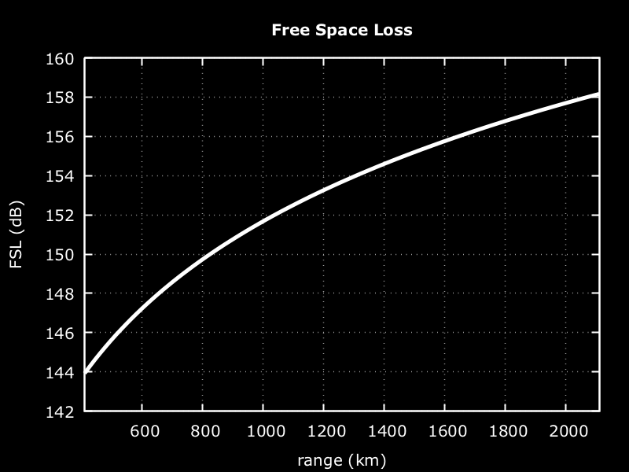
Eng. Methodology – Data Link Budget
Ben S
FSL = 158 dB for link budget calculation

Slide 85
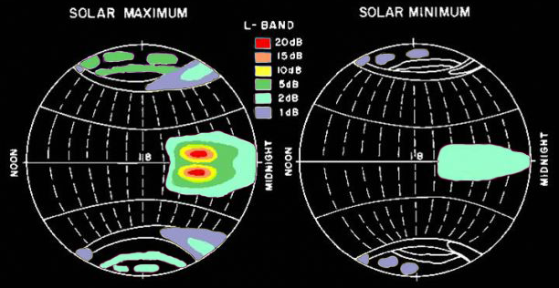
Eng. Methodology – Data Link Budget
Ben S
Atmospheric Losses
Ionosphere
Faraday Rotation - assuming circular polarization, negligible effect
Scintillation, mid-latitudes (<1 dB)
Adapted from: Istituto Nazionale di Geofisica e Vulcanologia, Roma2 Department, Aeronomy
URL: http://roma2.rm.ingv.it/en/themes/11/ionospheric_scintillation

Slide 86
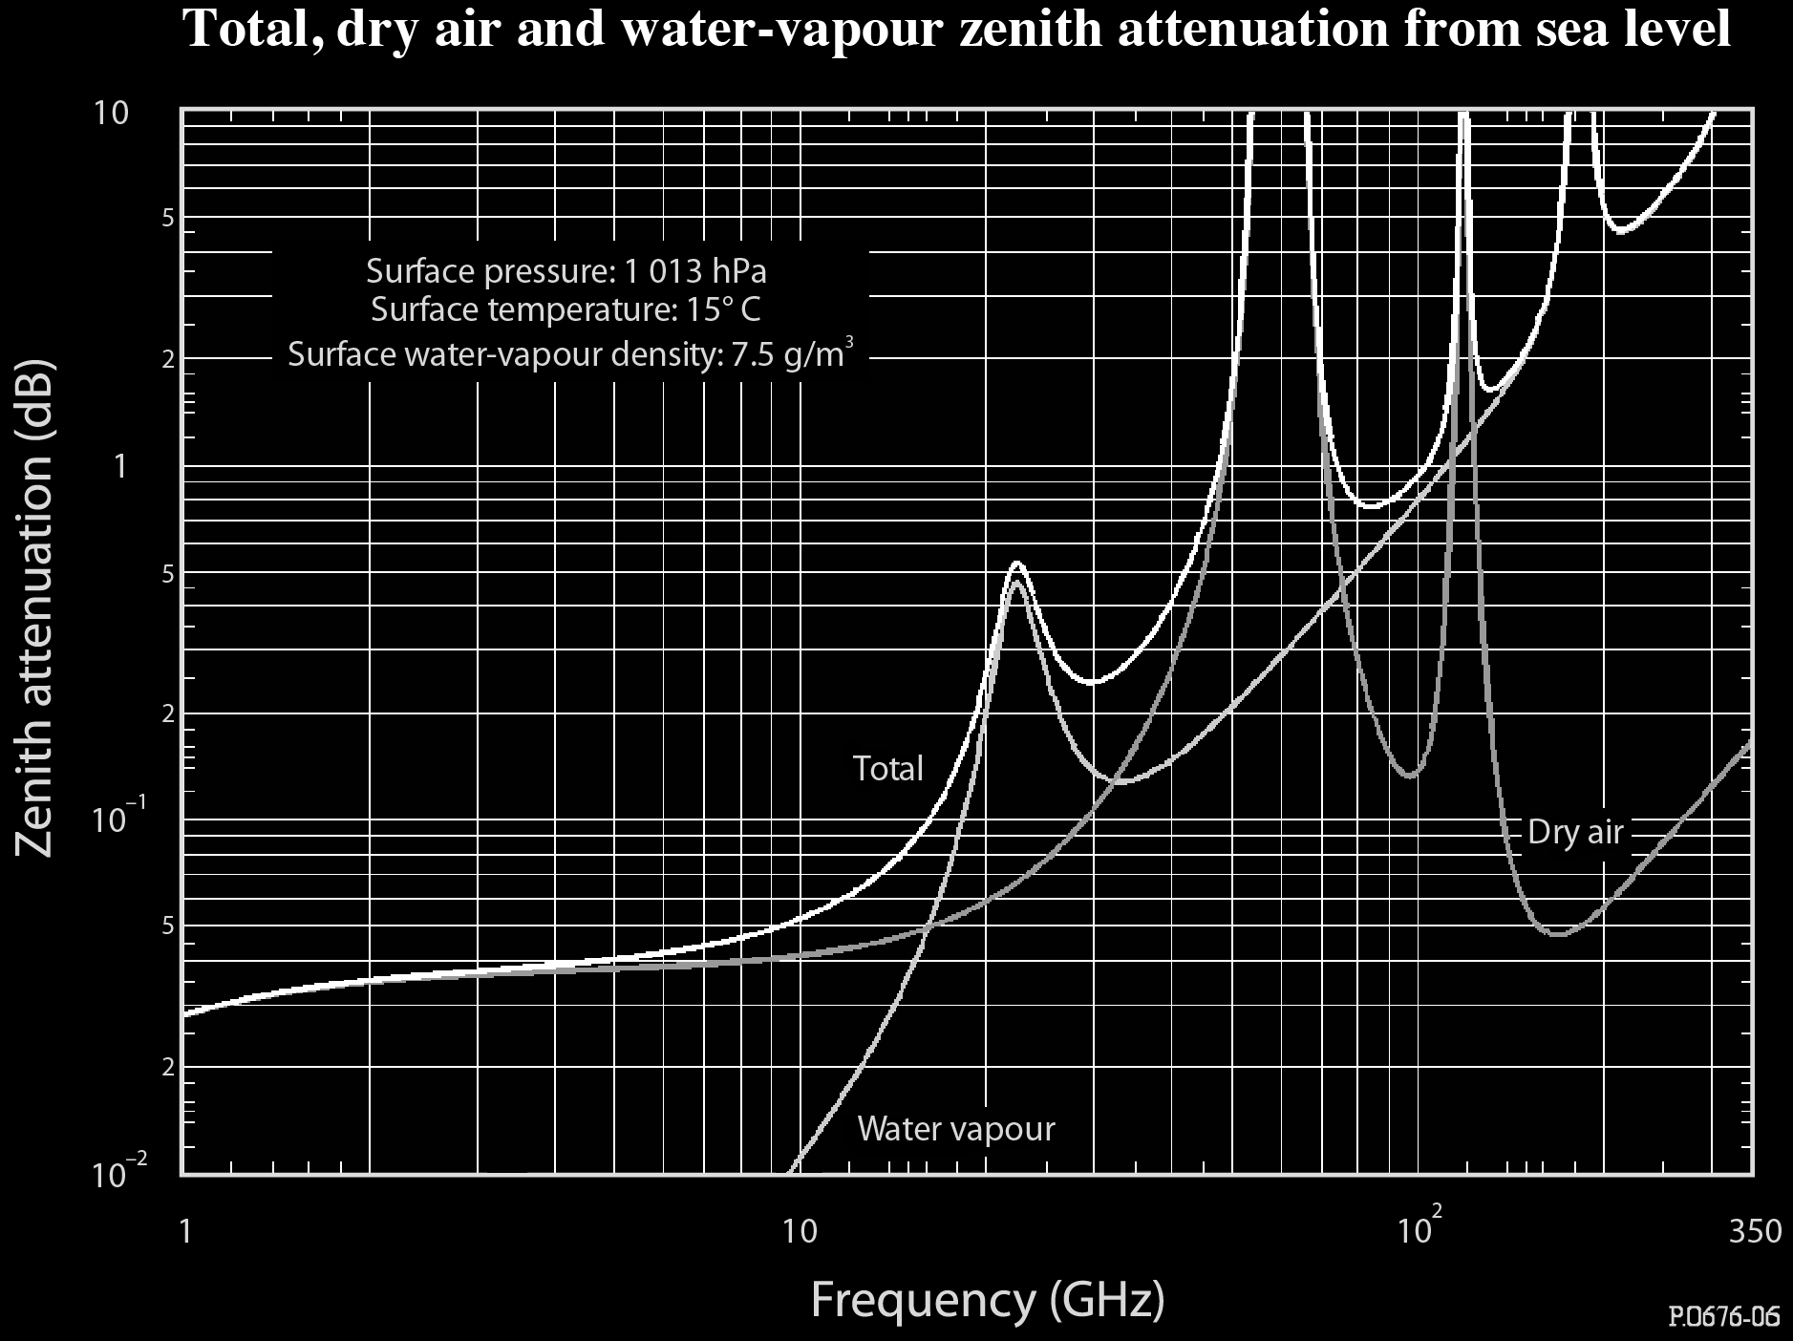
Eng. Methodology – Data Link Budget
Ben S
Atmospheric Losses
Ionosphere
Faraday Rotation - assuming circular polarization, negligible effect
Scintillation, mid-latitudes (<1 dB)
Troposphere
Extrapolation to 915 MHz
Zenith attenuation = 0.025 dB
TL_{max} = 0.025 dB × csc(2°) = 0.72 dB
Adapted from: International Telecommunication Union, Recommendation ITU-R P.676-9

Slide 87
Eng. Methodology – Data Link Budget
Ben S
Atmospheric Losses
Ionosphere
Faraday Rotation - assuming circular polarization, negligible effect
Scintillation, mid-latitudes (<1 dB)
Troposphere
Extrapolation to 915 MHz
Zenith attenuation = 0.025 dB
TL_{max} = 0.025 dB × csc(2°) = 0.72 dB
Other Losses
Weather conditions (e.g. rain)
Depolarization (~2 dB)
Temporary effects (ignore)
Total estimated atmospheric loss
AL = 3 dB
Notes:
Depolarization ice and rain International Radio Consultative Committee (CCIR)

Slide 88
Eng. Methodology – Data Link Budget
Ben S
Pointing Losses
Off-axis loss at CubeSat
Dependent on final satellite design, (< 1 dB)
Off-axis loss at Ground Station
Generally small (< 1 dB)
Antenna orientation misalignment
Depolarization, assuming circular polarized transmission, theoretical max 3 dB.
Estimated pointing loss
PL = 4 dB

Slide 89
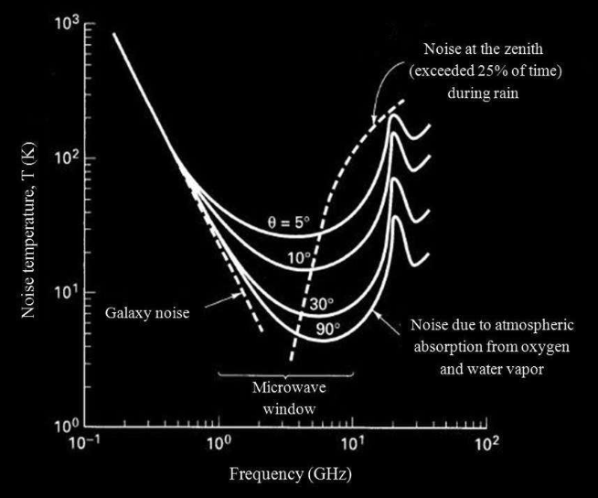
Eng. Methodology – Data Link Budget
Ben S
Noise
Thermal Noise (~400 K)
Antenna temperature
Clouds
Sky Noise (< 100 K)
Background Galaxy noise
Ground Noise (< 100 K)
Cable losses
Overall < 1000 K
Adapted from: Protocol of Communications for VORSAT satellite
URL: http://paginas.fe.up.pt/~ee97054/Link%20Budget.pdf
Notes:
Antenna at 115 C

Slide 90
Eng. Methodology – Data Link Budget
Ben S
Putting it all together
Ground station signal gain
AG = 30 dB
Power received at ground station
P_{r} = EIRP – FSL – AL – PL + AG
P_{r} = 1 dBW – 158 dB – 3 dB – 4 dB + 30 dB = -134 dBW = 40 fW
Notes:
Equivalent Isometric Radiated Power minus propagation losses
GA gain ground antenna 30 dB
Ebno = energy per bit divided by the noise spectral density
B = bits/sec bitrate

Slide 91
Eng. Methodology – Data Link Budget
Ben S
Putting it all together
Signal to noise
P_{r} = 40 × 10 ⁻¹⁵ W
B = 115 kbps
k_{B} = 1.381 × 10 ⁻²³ J/K
T < 1000 K
Bit Error Probability
E_{b}/N₀ > 25
P_{e}< 10⁻¹²
Notes:
Equivalent Isometric Radiated Power minus propagation losses
GA gain ground antenna 30 dB
Ebno = energy per bit divided by the noise spectral density
B = bits/sec bitrate
Erfc = complimentary error function

Slide 92
Design – Data Link Budget
Ben S
Aerospace’s ADV radio and ground network
Proven downlink 10-15 MB per 24 hour period for LEO satellite (TRL 9)
Aerospace CubeSat comparison
Same operating frequency (914.7 Hz)
Closed link-budget with 1.2 W antenna at 650 km altitude
10 MB per 24 hour period
Notes:
TRL – Technology readiness level

Slide 93

Lessons Learned
Aerospace
Engineer
Ethan A

Slide 94
Lessons Learned
Ethan A
Engineering process is cyclical
Start simple and build to complexity
Working and communication effectively in group
Gathering information
Research papers
Data sheets
From vendors
Balancing time
Work ~ 25-20 hr
School ~ 18 credits
Project ~ 3 hrs/week

Slide 95
Individual Contributions
Ethan A
Power management
Research into power system
Components chosen
Power budget
Power system operations / communications
Power system FMEA

Slide 96
Methodology
Ethan A
Research
Calculation
Pencil and paper
Microsoft excel

Slide 97
Life-Long Learning
There’s no ‘I’ in team… but there is a ‘me’ if you jumble it up a bit
The whole is greater than the sum of its parts
You must hold yourself responsible
Research as much as you can, then look again
Most problems have known solutions

Slide 98
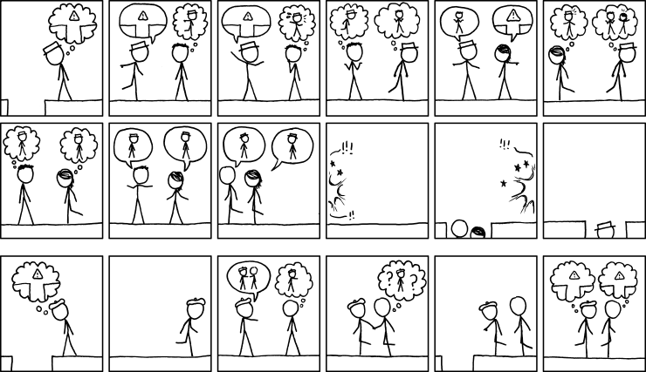
Communication

Slide 99
Communication
Clarity is key
Email works… if everyone sees it
Verify verify verify
Don’t be afraid to ask questions

Slide 100
Individual Design Contribution
Research of Attitude Determination
Sun sensors, earth horizon sensors, gyros and star sextants
Where we are in space
Applications?
Vector matching solution

Slide 101
Lessons Learned
Nick J
Redundancy in design is imperative
Computer software is nice, but don’t lose faith in your own calculations
Power determination in space is challenging
Having a negative power budget deems the craft ‘space debris’
Time management skills
Balancing a long term project proved more challenging than I had initially though
Creates a need to prioritize
Learning is life-long

Slide 102
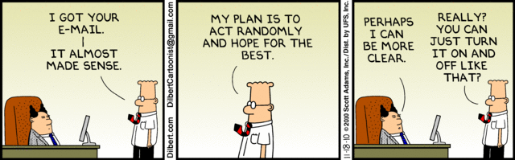
Communication
Nick J
Established a foundation of teamwork amongst SOCRATES sub teams
Made it simpler to ask for help
Willingness to step out of comfort zones to assist teammates with engineering tasks
Presented a platform to convey ideas and motivations individually, but with a common end goal
Established relationships within industry
Company consultations for item specifics

Slide 103
Individual Design Contribution
Nick J
Structure Contributions:
Performed thermal analysis throughout the orbit using STK SEET (Space Environment and Effects Tool)
Used to determine surface temperatures and required heat shielding
Studied the lighting, penumbra, and umbra durations for a broader understanding of the solar power available, as well as the thermal activity during orbit
Power Contributions:
Performed case studies for needed components
Evaluated the options available to select the correct components to satisfy the needs of the other subsystems depending on power consumptions
Worked with other team members to create a power budget for SOCRATES
Calculated internal energy dissipation (0.32 W)
General research on various different systems and power requirements
Contributions to presentations
Individual Time Commitment: ~6hrs/week , 15 weeks, ~90 hours

Slide 104
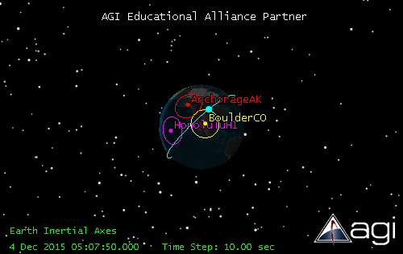
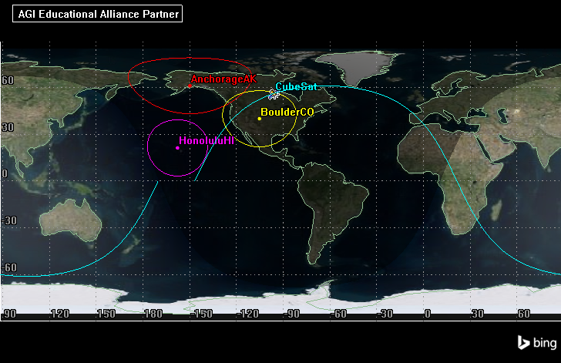
Engineering Methodology
Nick Janak
Preliminary calculations performed with pencil and paper
Studied material properties to determine a passive method of thermal control
Absorptivity and Emissivity of materials on SOCRATES surface
STK SEET (Space Environment and Effects Tool)
In addition to the shared files from Jacob’s STK analysis
Analysis of the incident radiation
Analysis of Space Vehicle temperatures

Slide 105
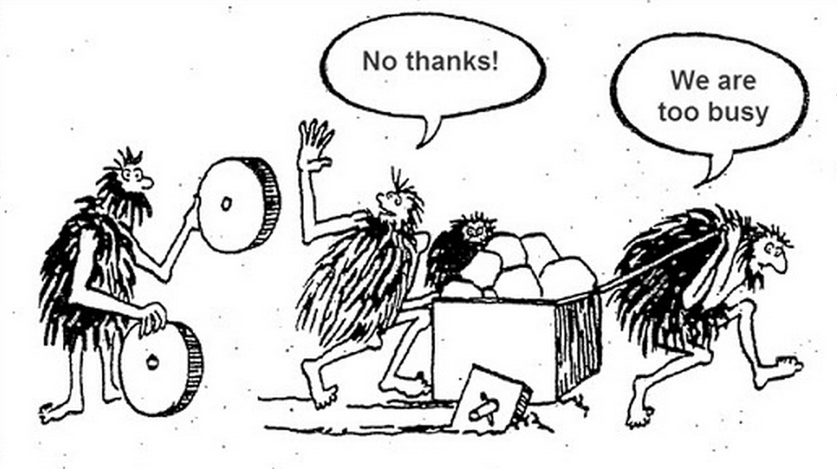
Lessons Learned
Jake G
don't reinvent the wheel
You can never know too much
Don’t be afraid to ask
(its okay to not know everything)
Double Check EVERYTHING!!!!!!!!!!!!
Remember to have fun
But only so much
https://trimaps.com/custom-map-users/interactive-map-made-easy-for-developers

Slide 106
Individual Design Contributions
Jake G
GPS
Parts Choice
Antenna Choice
Attitude determination
Initial Research on Algorithm
STK
Hours: ~100

Slide 107
STK
Jake G
Used for on CubeSat
Model
Power Budget
Link Budget
GPS Verification
Very Powerful
Not just used for Space Applications

Slide 108
Individual Design Contributions
Justin S
Initial Power Requirements
Power Components and Space Heritage
GomSpace vs ClydeSpace
Product Research & Determination
Solar Panel Configuration
Power Supply and Budget Modeling

Slide 109

Individual Design Contributions
Power Budget Modeling
1.5 hour orbit period
0.98 hour sunlight period
1 degree/ 15 seconds
6.26 W/h efficiency at 80 degrees Celsius
Took percent offset from perpendicular position relative to sunlight, and calculated wattage per second in that position. Added for total sunlit orbit for each solar panel.
~ 10.5 – 13 W gained per idling orbit, ~ 12.7 W per transmitting orbit
118
163
73
208
28
236
0
Unlit portion of orbit

Slide 110
Lessons Learned
Justin S
Teams are most efficient when there is good communication
Best way to communicate is having everyone working together in same location/time
Well organized documentation is key to team’s success
Strong leadership is more critical than most people think
Outside obligations take away from the quality of the project
There’s always something you missed or don’t fully understand about a project. Review data sheets multiple times. If you think you understand a product within the first hour of reviewing it… you probably don’t truly know half of it
Sometimes your theoretical calculations are the best results you can get
Everyone will have their separate way of modeling a situation
Look for provided sources before you attempt to calculate everything for yourself

Slide 111
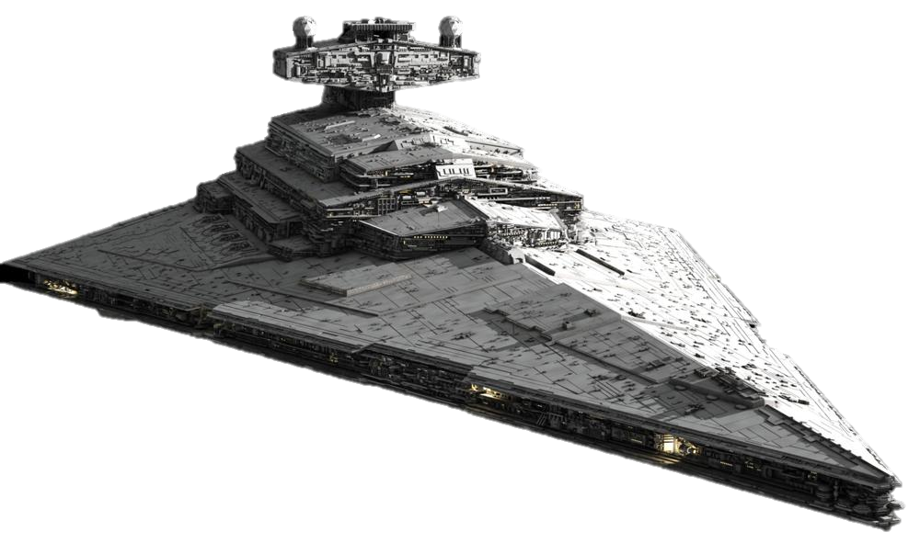
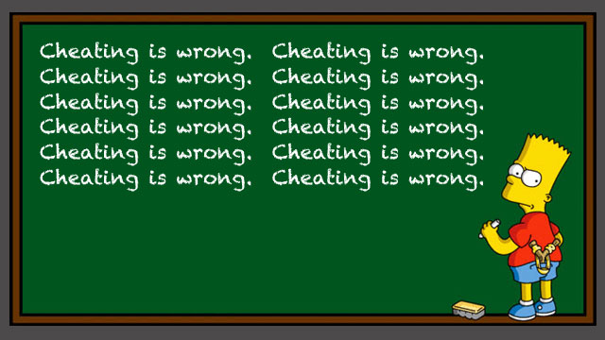
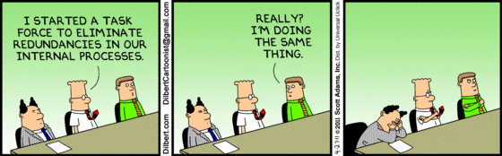
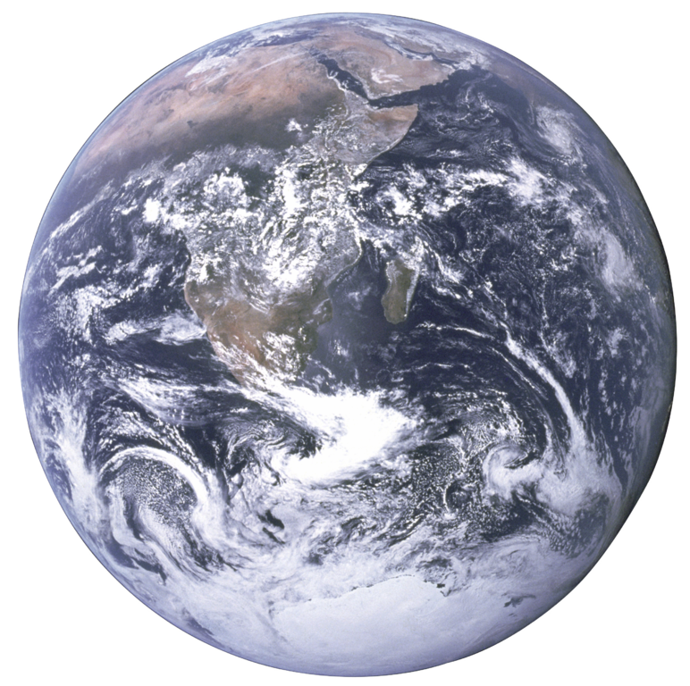
Lessons Learned
Tim K
Don’t do something that’s already been done
The world doesn’t move at your pace
Keep it simple
Communication is key to the team’s environment
Remind yourself of the project’s goals and have fun
Don’t do something that’s already been done…
Communication is key to the team’s environment
The world doesn’t move at your pace
Remind yourself of the project’s goals and…
KEEP
IT
SIMPLE
Have fun!

Slide 112
Individual Design Contribution
Tim K
Communication Hardware research
Radios and Antennas
Gantt chart
Hours: ~75

Slide 113
Individual Design Contributions
Nick S.
Attitude determination
Initial research into hardware
Passive Magnetic Attitude Control System
Research
Coding Matlab simulation
PMACS verification
Hours: ~80
Notes:
SLIDE 64, Magnets are annoying. Lots of quality time with matlab.

Slide 114
Lessons Learned
Nick S.
Importance of Consistency
Being gone for ~1 month on a 3-month project makes things difficult
Organization makes your life easier
People want to help (so ask questions)
Work off of previous research, don’t start from scratch
Space is difficult
Notes:
SLIDE 65, Leaving for Australia took me out of the loop for the project and I had to spend time catching up with where things were. Keeping things together an organized makes things happen. You don’t design in a vacuum. Ask people and you can find help. One paper from our sponsor allowed me to create a matlab simulation to verify our PMACS. Putting something in space makes all of your challenges that much tougher. Orbits, reliability, power; all become really hard when you have zero-margin for failure. I also learned that in space things get hot and cold. I knew that, but never the magnitude of the variation. Also, I found

Slide 115
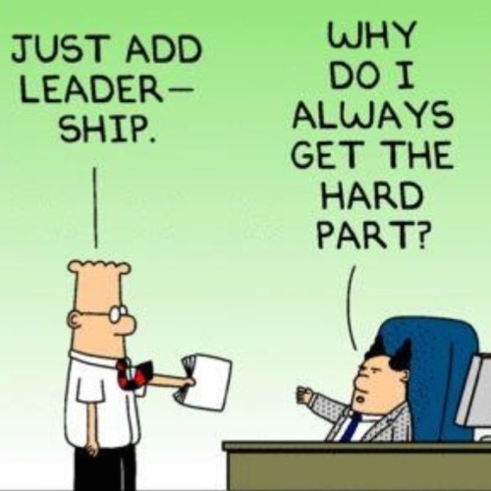
Lessons Learned
Charlie D
Research is a key element in design
If you didn’t find what you were looking for, look again
There is a specific tool for the job
DO NOT just swing a bigger hammer
Leadership is harder than I thought
Spend a lot of time “herding cats”
Group email tasks do not work
Assigning individual responsibilities does.
Associate someone’s pride to the job, it will get done.
Engineering is circular and asymptotic
http://dilbert.com/strip/2010-05-21

Slide 116
Communication
Charlie D
Establishing a team system worked well
Distributed the “big picture” workloads within the teams
Other subsystems can be directed to the correct persons for the answers they need.
Software
Email, although convenient, do not have the weight of a conversation
GitHub
…
6/10 would use again

Slide 117
Individual Design Contribution
Charlie D
Team Leader
Communicated directly with sponsors and other outside contributors
Communicated with Josiah DeLange (HASP) for work on GRID
Spent majority of time catching up to what the sub teams have discovered or changed
General research on various all systems
Presentations (PowerPoint King)
Structure Contributions:
Solidworks Model
Working with centers of mass and moments of inertia
note: most industry supplied .step files are wrong.
3D design, dealing with .step files that are not correct
Individual Time Commitment: ~9hrs/week , 15 weeks, ~135 hours

Slide 118
Engineering Methodology
Charlie D
Scientific Method:
Ask a question What does SOCRATES need to do
Research Other CubeSats; successes and failures
Hypothesis First conceptual model
Test Simulations, simulations, and more simulations!
Analyze Why did everything fail?
Return to step 2 Not again!@?#

Slide 120
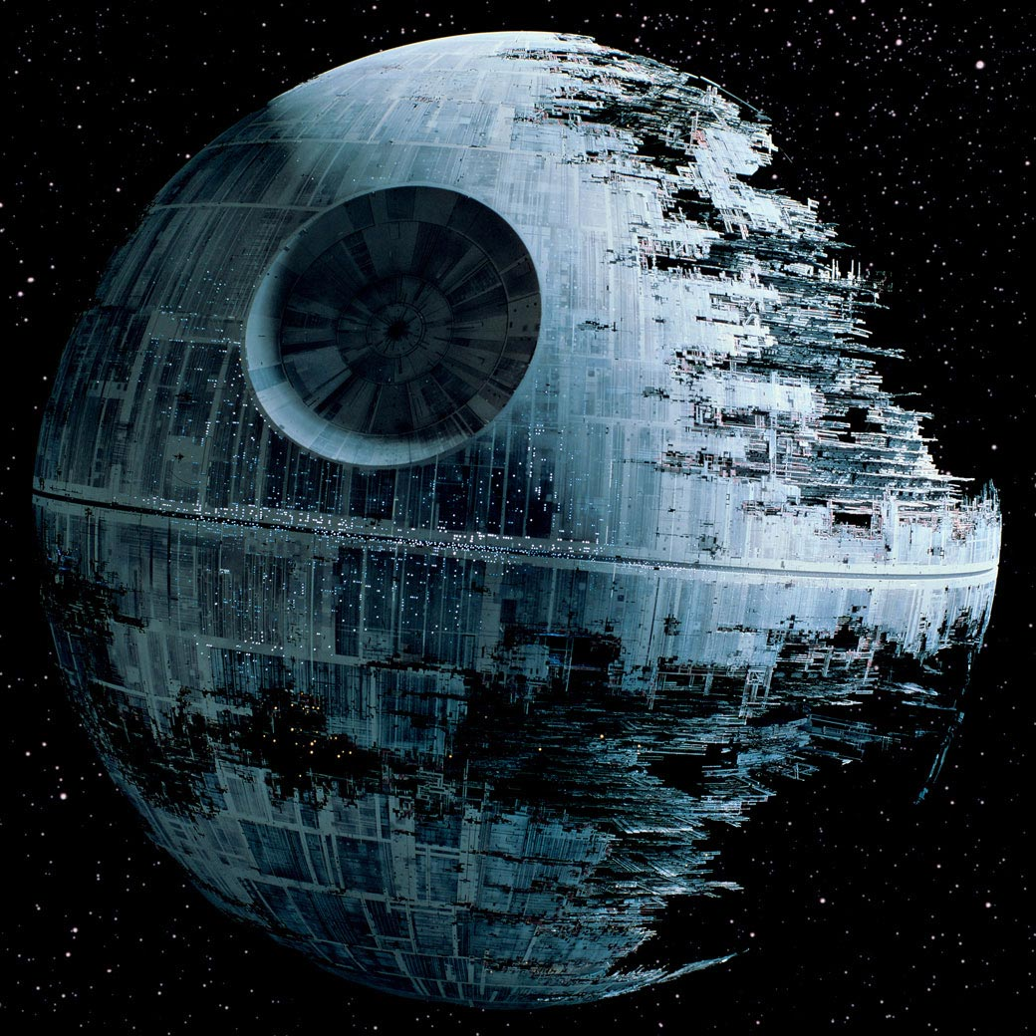
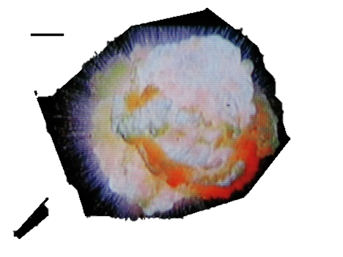
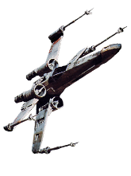
THE END
This slide intentionally left blank.

